Slide 1

Handwritten Digit Recognition
Prepared By:
SHIVANGI MODI DISHA PADSHALA

Slide 2
Contents of Presentation
1. Background Theory
2. Problem Statement
3. Why we need this Handwriting recognition?
4. Proposed System and Scope of System.
5. Hardware and Software Requirements (Tools and Technology to be used to build and deploy)
6. Project Definition and Planning (Gantt Chart).
7. Implementation Details.
8. Limitations and Future Scope
9. References.

Slide 3
Background Theory and Problem Statement
Handwriting character recognition is one of the research fields in computer vision, artificial intelligence, and pattern recognition. A computer application that performs Handwriting Recognition can be argued to have the ability to acquire and detecting characters in pictures, paper documents, and other sources and convert them into electronic format or machine-encoded form.
The system may obtain handwriting sources from a piece of paper through optical scanning or intelligent word recognition.
In other words, Handwriting Recognition may involve a system detecting movements of a pen tip on the screen to get a clue of the characters being written.
Handwriting Recognition can be classified into two categories:
Offline Recognition
Online Recognition
Offline Handwriting Recognition involved the extraction of text or characters from an image to have letter codes that can be used within a computer. A system is provided with a handwriting document to read and convert the handwriting to a digital format.
Online handwriting recognition, on the other hand, involved automatic detection or conversion of characters as they are written on the specialized screen. Among the existing techniques that are used to model, and train handwriting character recognition include Neural Network, Hidden Markov Model (HMM), Machine Learning, and Support Vector Machine, to mention a few.

Slide 4
Problem Statement
Handwriting Recognition can be considered as a problem of supervised learning and classification from a discriminative classifier point of view, with this assumption, Support Vector Machine which a discriminative classifier is considered as one of the models that can be effective in developing handwriting recognition systems.
Like a neural network, a Support Vector Machine is a subset of machine learning.
The Support Vector Machine refers to a supervised learning model that is dependent on learning algorithms for classification and regression analysis.
A Support Vector Machine can be considered as a computational algorithm that finds out a hyperplane or a line in a multidimensional space that separate classes. A Support Vector Machine is an approach where the main aim is to find the best separation hyperplane.

Slide 5
Why we need this Handwriting recognition?
The Handwriting Recognition Systems can be inspired by biological neural networks, which allow humans and animals to learn and model non-linear and complex relationships.
That means they can be developed from the Artificial Neural Network.
The human brain allows individuals to recognize different Handwriting objects such as digits, letters, and characters. However, humans are biased, meaning they can choose to interpret handwriting letters and digits differently.
Computerized systems, on the other hand, are unbiased and can do very challenging tasks that may require humans to use a lot of their energy and time to do similar tasks.

Slide 6
Proposed System
The aim of a handwriting digit recognition system is to convert handwritten digits into machine readable formats.
The main objective of this work is to ensure effective and reliable approaches for recognition of handwritten digits and make banking operations easier and error free.
The idea is to take a large number of handwritten digits, known as training examples, and then develop a system which can learn from those training examples.
In other words, the neural network uses the examples to automatically infer rules for recognizing handwritten digits.

Slide 7
Scope of System
The main objective of this research is to design an expert system for Handwriting Character Recognition using neural network approach.
Other objectives include:
To address the issue of accuracy in handwriting character recognition systems by developing a system that will use efficient technology for recognizing handwriting characters and words from image media.
To investigate and demonstrate the usefulness of neural network technology in development of efficient handwriting character recognition systems.

Slide 8
Hardware and Software Requirements (Tools and Technology)
Keras libraries
TensorFlow libraries
Matplotlib libraries
NumPy libraries
Python version

Slide 9
Project Definition and Planning (Gantt Chart).
Handwriting Character Recognition refers to the computer's ability to detect and interpret intelligible handwriting input from handwriting sources such as touch screens, photographs, paper documents, and other sources. Handwriting Characters remain complex since different individuals have different handwriting styles.
This aims to report the development of a Handwriting Character Recognition System that will be used to read students and lectures handwriting notes. Different techniques and methods are used to develop a Handwriting Character Recognition System.
The use of neural networks for recognizing Handwriting Characters is more efficient and robust compared with other computing techniques. This outlines the methodology, design, and architecture of the Handwriting Character Recognition System and testing and results of the system development.
The aim is to demonstrate the effectiveness of Neural Networks for Handwriting Character Recognition.

Slide 10
Gantt Chart

Slide 11
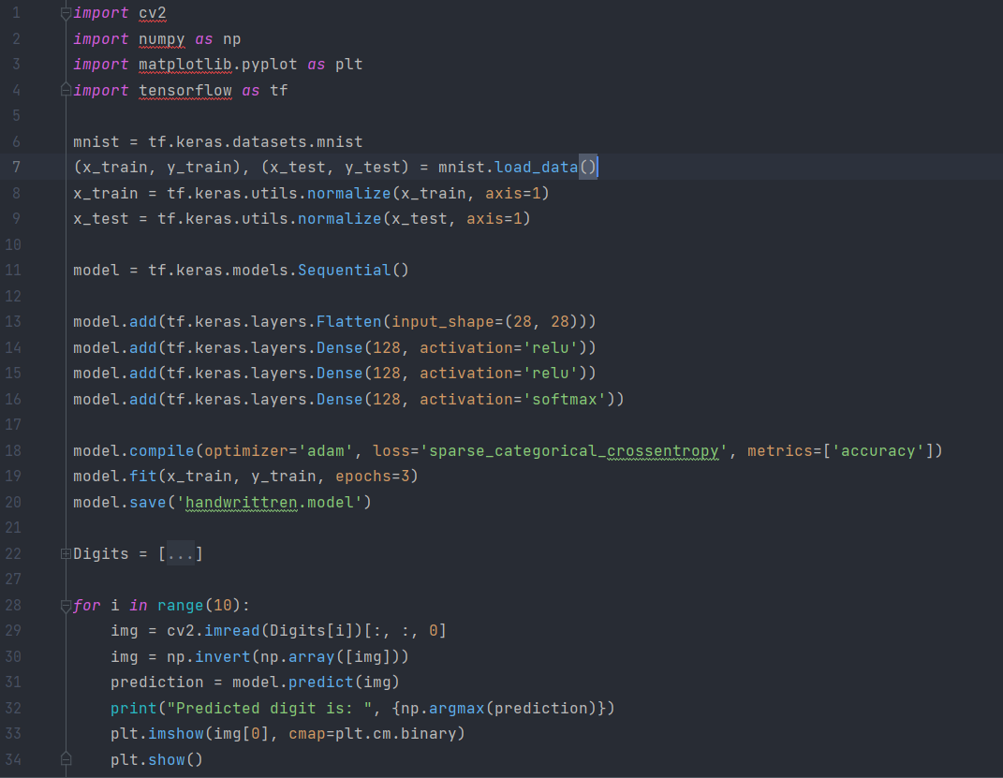
Implementation Details

Slide 12
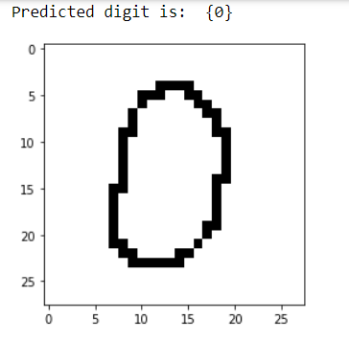
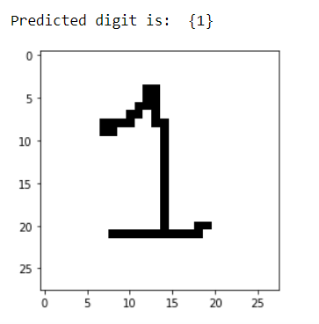
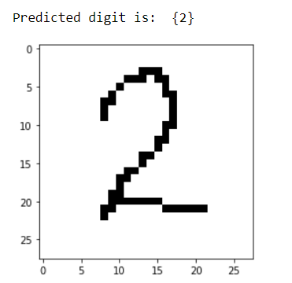
Implementation Details

Slide 13
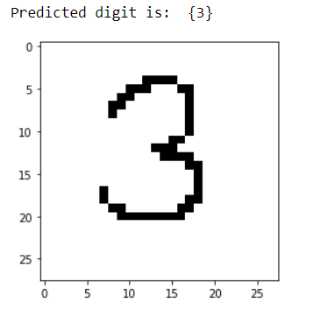
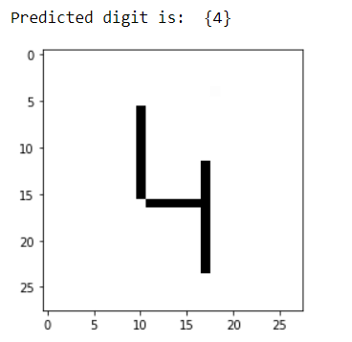
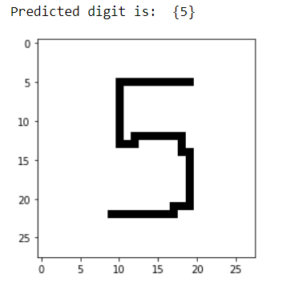
Implementation Details

Slide 14
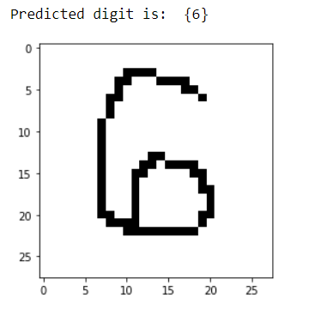
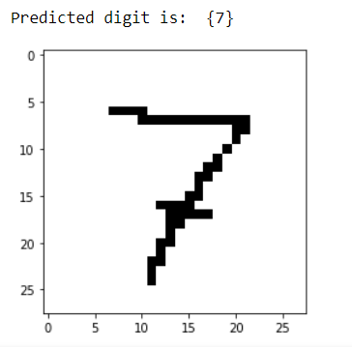
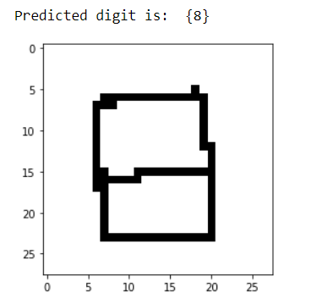
Implementation Details

Slide 15
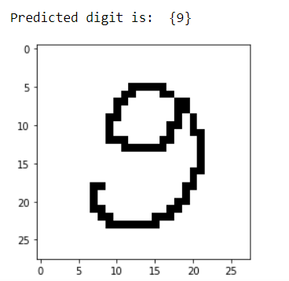
Implementation Details

Slide 16
Limitations
The only limitation is that sometimes because of some user errors, it cannot recognize the digit properly.
When the written digit is too rough and cannot be recognized properly, the accuracy may become low and will give the wrong result.

Slide 17

References
https://thesai.org/Downloads/Volume11No7/Paper_19-Handwriting_Recognition_using_Artificial_Intelligence.pdf
https://www.sciencedirect.com/topics/computer-science/handwriting-recognition
https://www.researchgate.net/publication/343345535_Handwriting_Recognition_using_Artificial_Intelligence_Neural_Network_and_Image_Processing

Slide 18
Thank You

Slide 19
Handwritten Digit Recognition
Prepared By:
SHIVANGI MODI DISHA PADSHALA

